Slide 1

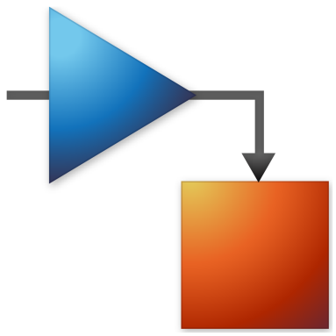
University and MathWorks Present: Circuit Simulation Onramp

Slide 2
Today:
6:15 pm – 6.30 pm: Set-up
Intro to Circuit Simulation
Create MathWorks account
Log in to Circuit Simulation Onramp / Test MATLAB Online
6.30 pm – 8.00 pm: Circuit Simulation Onramp (on your own)

Slide 3
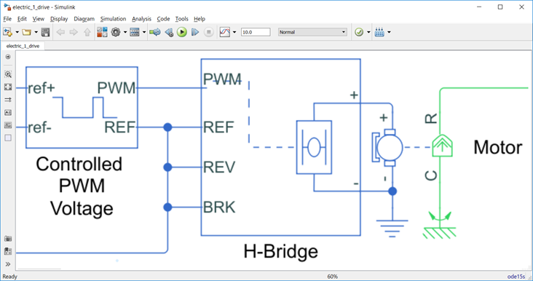
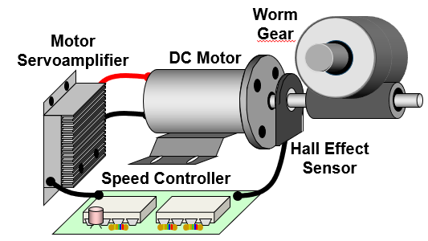
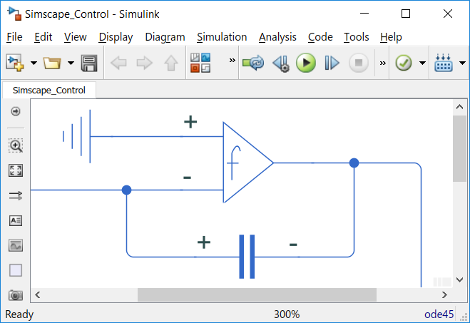
Circuit Simulation
What is Circuit Simulation?
Why is it important?
Notes:
What is Circuit simulation? A process in which a model of an electronic circuit is created and analyzed using various software algorithms to predict and verify the behavior and performance of the circuit.
Why is it important? Design electrical and electronic circuits, test their operation, analyze their performance and make necessary changes before moving forward with manufacturing.

Slide 4
Build circuits for simulation using Simscape electrical component models

Slide 5
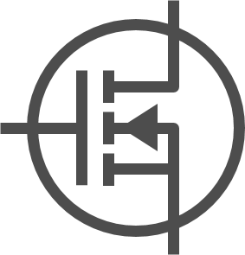
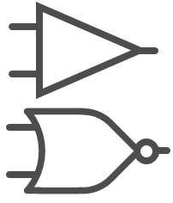
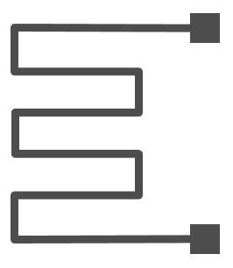

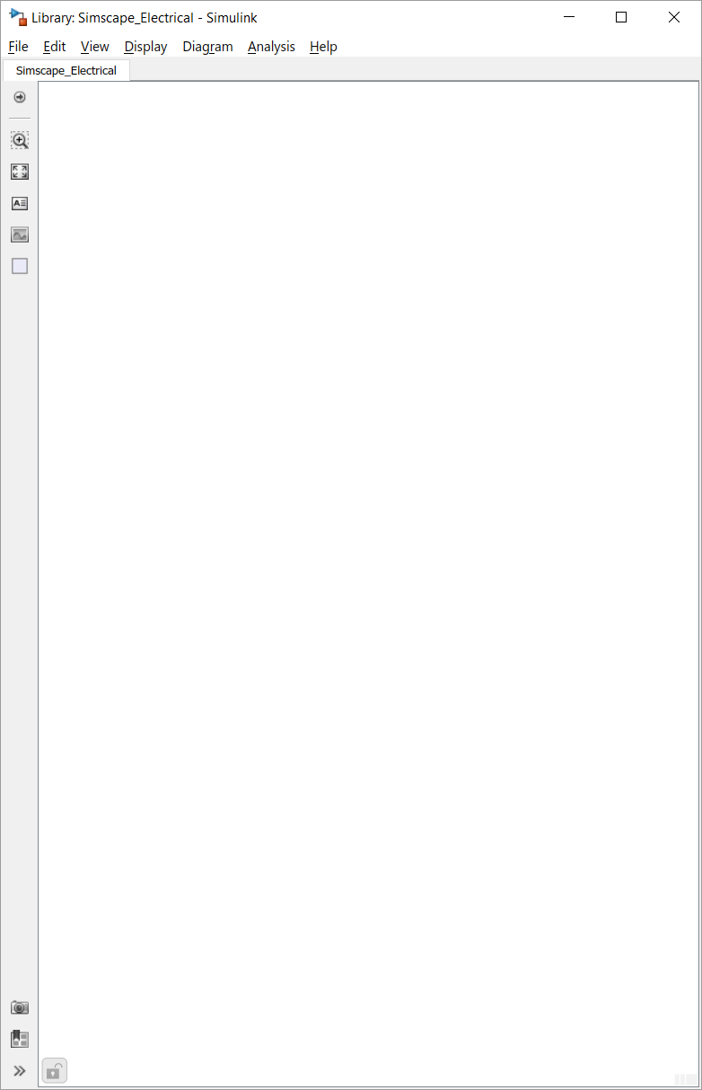
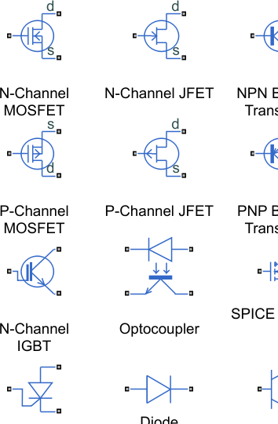
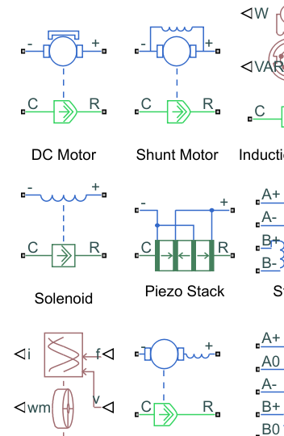
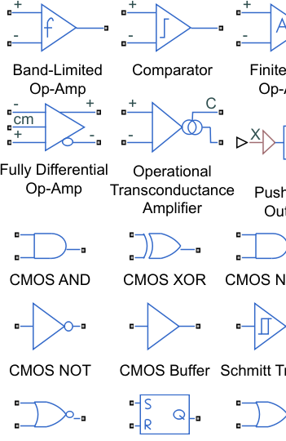
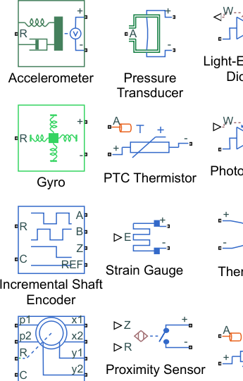
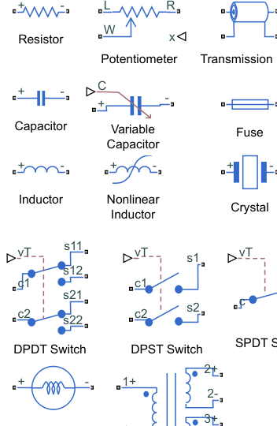
Simscape Electrical Component Models
Semi- conductors
Motors, Actuators
Op-Amps, Logic Gates
Sensors
Passive Devices

Slide 6




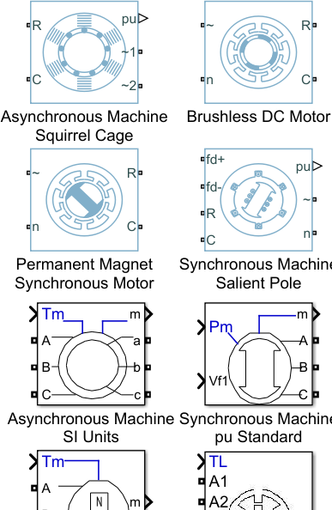
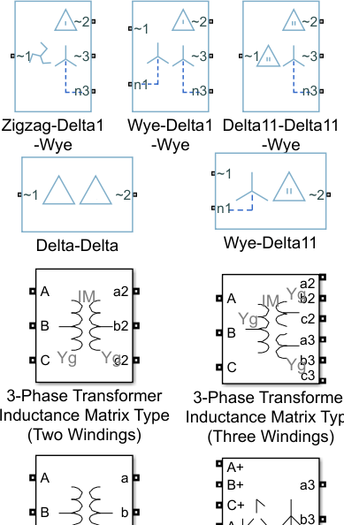
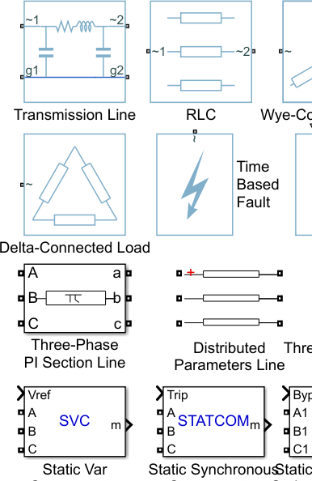
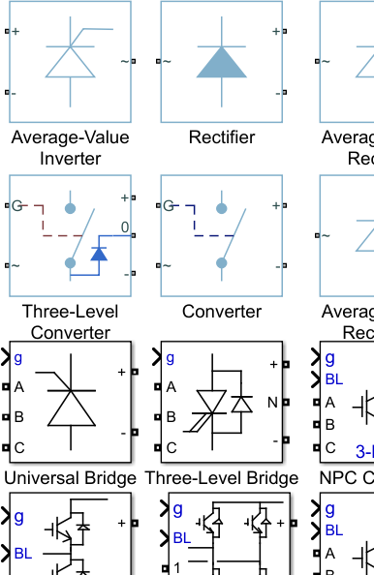
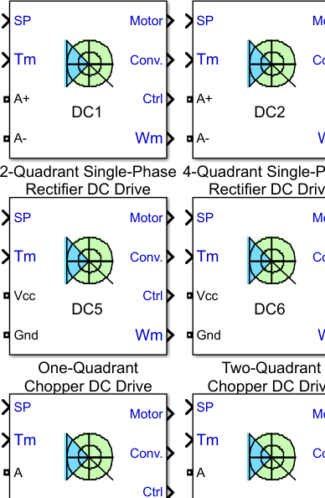
Simscape Electrical Component Models
Generators, Motors
Transformers
Lines, FACTS
Converters
Electric Drives

Slide 7
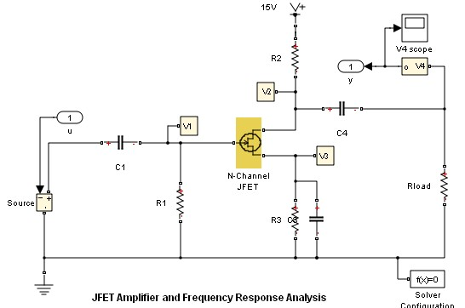

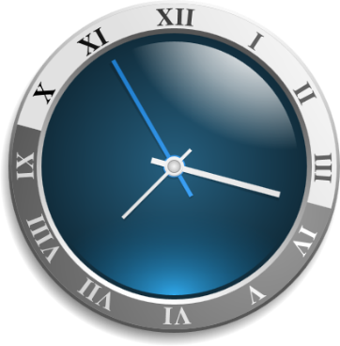
Let us see how RF behavior is integrated into communications models?
RF transient simulation requires time steps that are commensurate with the RF carrier frequency.
Baseband PHY layer simulation time steps are based on the data rate of the generated waveform.
Circuit Envelope employs multi-carrier simulations to add RF impairments to waveforms
Radio Frequency
Signals
Small simulation time-step
Long Simulation Runs
~10psec
~5GHz
Notes:
At first glance, it would seem that integrating RF front-ends into PHY layer models to do architectural exploration would be prohibitive as the digital baseband simulation makes use of time steps that are related to the bandwidth of the digital waveform, while the required time steps for performing time-based simulation are inversely proportional to an integer multiple of the fundamental carrier of the RF system. You can see an example of this in the accompanying slide. The circuit envelope simulation technique allows you to combine both domains together wherein you can take time steps that are based on the bandwidth of the digital waveform, with multi-carrier simulation so that all of the key spectral content added by the RF front-end is included in your PHY layer simulation.

Slide 8
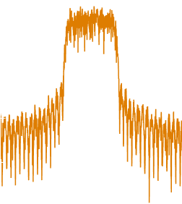

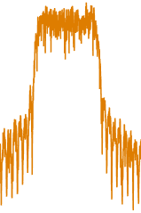




Circuit Envelope to Trade-off Fidelity and Speed
Equivalent Baseband
Simulation speed
Spectrum
Carrier
freq
Circuit Envelope
Spectrum
freq
DC
Carrier 1
Carrier 2
True Pass-Band
Spectrum
freq
Modeling fidelity
Notes:
Let’s take a look at a pictorial representation of what I described in the previous slide.
Digital communications engineers typically use equivalent baseband where they can capture near band impairments such as noise, third order intermodulation products along with frequency dependent small signal behavior. This method is limited to simulation around a single nominal carrier and doesn’t capture behavior at even order intermodulation products or at frequency harmonics of the fundamental carrier. The decreased fidelity permits simulations to run in a shorter period of time.
On the other end of the spectrum, there is the true pass-band transient simulation technique. The very small steps used in this type of simulation facilitates simulation of RF systems from DC to light wave frequencies, capturing ALL of the spectral content generated by the RF system. This type of simulation is necessary when validating a final board or transistor level design, but it is not conducive to doing RF architectural exploration which a RF systems engineer does at the early stages of a design.
In between, there is the circuit envelope simulation technique. Based off of the fundamental carrier frequency of the system along with LO frequencies of each respective up-conversion or down-conversion stage along with co-existence signals and other interferers, the circuit envelope technique does narrowband simulation around not only the carrier frequency of interest in the system but also simulation at each of the harmonics and intermodulation products resulting from the mixing of the aforementioned sources. The step time used in the circuit envelope engine is commensurate with the step time of the baseband waveform. The use of narrowband, multi-carrier circuit envelope simulation permits for additional fidelity over equivalent baseband methods, while capturing nearly all of the key spectral content that would be determined using true passband simulation with the one difference is that the step time used in circuit envelope is at least one order of magnitude larger that that used in true pass band transient simulation.

Slide 9
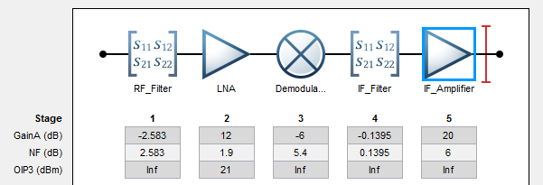
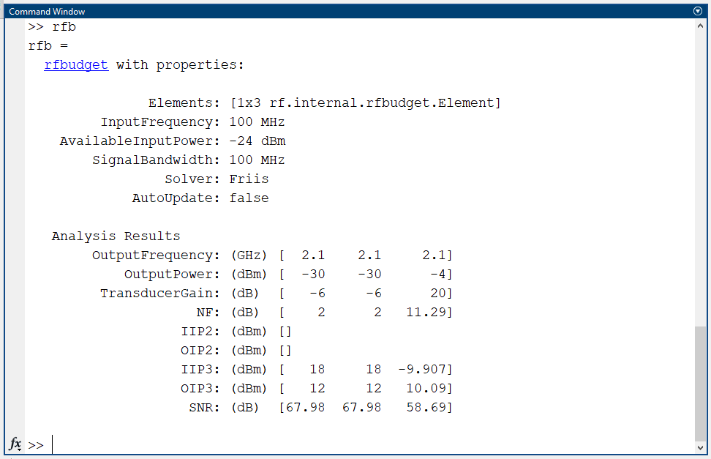
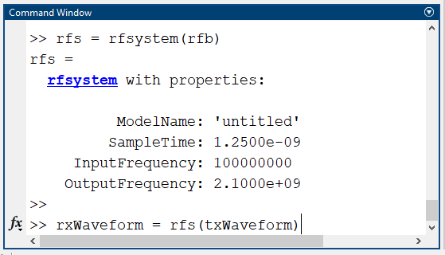
Integrating RF Circuit Simulation into MATLAB
Notes:
On the accompanying slide you can see the new workflow introduced in R2021A of MATLAB where RF Circuit Envelope simulation is supported in MATLAB. This workflow consists of three main parts, development of a RF cascade in the RF Budget Analyzer; exporting of the RF Budget object to the MATLAB workspace; and generation of the rfsystem() object and its subsequent use to add RF impairments to baseband digital waveforms.
The rfsystem() object is in essence is a wrapper for a RF Blockset Circuit Envelope network. The rfsystem() object permits MATLAB users who do not wish to enter the Simulink environment to develop sophisticated RF front end models via the RF Budget Analyzer Application. Via MathWorks system object technology users have the option to open and edit the associated Simulink RF Blockset model wherein blocks can be added that are not supported within the RF Budget Analyzer application or you can add digital controllers such as those used in RF transmitter linearization.
As we will see on the next slide, the rfsystem() object can be used to support a number of sophisticated workflows common to 5G wireless systems development.

Slide 10
How can Circuit Simulation be used in the real world?

Slide 11
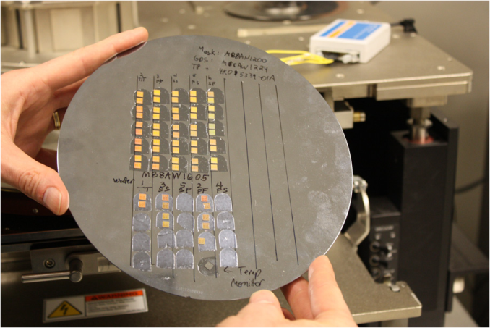
Fujitsu Develops and Tests State-of-the-Art 40 Gbps Optical Transponder
Challenge
Develop a 40 Gbps serializer/deserializer integrated circuit for an optical transponder
Solution
Use Simulink to model and simulate key components of the design, and use MATLAB and Instrument Control Toolbox to automate chip testing and characterization
Results
First-silicon-success for components verified in Simulink
Faster verification of mixed-signal designs
Test time reduced by 90%
SERDES chips mounted on inert substrate for testing.
“By including circuit-level simulation results in our Simulink models we can simulate millions of cycles with the accuracy needed to account for noise and other transient effects. Simulink is the only tool fast enough for our jitter-tolerance simulations.”
- William Walker, Fujitsu Laboratories of America
Link to user story
Notes:
Primary Industry: Electronics and Semiconductors
Secondary Industries: Communications
Product Capabilities: Data Acquisition, Data Analysis, Mathematical Modeling, System Design and Simulation, Verification, Validation, and Test
Applications: Embedded Systems, Communications Systems
Products Used: MATLAB, Simulink, Instrument Control Toolbox
Country: USA
Fujitsu Develops and Tests State-of-the-Art 40 Gbps Optical Transponder
To keep up with mounting network traffic, telecom carriers and cable operators worldwide use optical networking solutions from Fujitsu Laboratories of America.
In response to the demand for higher data rates, Fujitsu designed, simulated, and tested 40 Gbps serializer/deserializer (SERDES) chips using MathWorks tools.
“Simulink enabled us to incorporate the results from sub-picosecond SPICE simulations into high-level simulations, modeling millions of symbols,” explains William Walker, a Fujitsu Laboratories of America vice president. “Later, with MATLAB and Instrument Control Toolbox we automated and accelerated the process of testing and characterizing the devices implemented in silicon.”
The Challenge
Fujitsu wanted the SERDES to consume no more than 4.5 watts; comparable systems consume 12 watts. This stringent power requirement led Fujitsu to switch from bipolar to CMOS technology for the SERDES chip. “While CMOS technology uses less power, it is typically slower than bipolar, and there is more process variation,” says Nikola Nedovic, a Fujitsu researcher. “As a result, designing with CMOS is much more difficult at the bandwidth and high data rates we are working with, making system modeling crucial to our success.”
Fujitsu needed highly accurate circuit simulations, but circuit emulators cannot handle the millions of symbols needed to simulate the effects of jitter and measure bit error rate (BER). “SPICE can simulate a few hundred symbols, but much more than that and the simulations become too slow,” says Nedovic.
Once the chip was fabricated, the engineers would need to thoroughly characterize and verify the device with a minimum of manual steps.
“By including circuit-level simulation results in our Simulink models we can simulate millions of cycles with the accuracy needed to account for noise and other transient effects. Simulink is the only tool fast enough for our jitter-tolerance simulations.”
- William Walker, Fujitsu Laboratories of America
The Solution
Fujitsu engineers used Simulink to model and simulate the SERDES chips and MATLAB and Instrument Control Toolbox to automate testing of the hardware prototypes.
In order to simulate the large amounts of data passing through the system, they modeled the most complex subsystems in the SERDES design—the clock and data recovery (CDR) unit and the limiting amplifier (LA)—in Simulink.
The engineers used SPICE and other circuit emulators to simulate the individual analog blocks that make up the CDR and LA. They then abstracted the detailed results from the SPICE simulations into Simulink blocks to create a much faster, higher-level representation.
For example, to model jitter in the voltage controlled oscillator (VCO), the team first used advanced circuit analysis tools to simulate 1/f noise in each transistor and thermal noise in each resistor. In Simulink they created an ideal model of the VCO, inserted noise sources, and adjusted the noise level until the Simulink model produced results that matched the circuit-level simulations.
The engineers assembled complete models of the CDR and LA and then used Simulink to simulate the millions of cycles needed to gauge BER and assess the performance of nonlinear subsystems. The Simulink models ran much faster than the circuit-level models, enabling them to simulate millions of symbols in a reasonable time frame.
After laying out the integrated circuit, the engineers reran their circuit-level simulations using the post-layout netlist. They could then measure second-order parasitic capacitive and resistance effects not accounted for in the preliminary design. They incorporated these effects into the Simulink models and reran simulations before sending the design to be fabricated.
Design verification test engineers wrote MATLAB scripts to automate the testing process. Using Instrument Control Toolbox, they controlled signal generators and collected data from spectrum, vector network, and communication signal analyzers. The scripts were also used to control on-chip built-in BER test circuits.
Modeling engineers characterized individual devices such as inductors, varactors, and field-effect transistors (FETs) using MATLAB. The engineers used this data to further improve the accuracy of their simulations by refining the device models used by SPICE simulators.
The final SERDES ICs consume just 3.5 watts—well below the initial power goal of 4.5 watts.
The Results
■ First-silicon-success for components verified in Simulink. “When we respin a chip, the costs can be up to $1 million,” says Walker. “Though there were some respins on this project, the subsystems that we simulated using Simulink—the CDR and the LA—were right the first time.”
■ Faster verification of mixed-signal designs. “We needed to ensure a BER of less than 1 bit per trillion, and at 40 Gbps, that cannot be done with circuit-level or hardware-description-level simulators,” says Nedovic. “With Simulink we simulated millions of cycles to measure BER and verified much of the design before fabricating our first chips.”
■ Test time reduced by 90%. “If we characterized FETs and other devices using manual tests instead of MATLAB scripts, it would take 10 times longer to get all the data we need,” says Walker. “Tests that require a full day to complete by hand can be completed in minutes—and the automated tests are more consistent.”
Learn more about Fujitsu: www.fujitsu.com

Slide 12
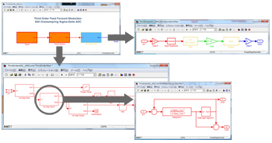
A Next-Generation Workflow for System-Level Design of Mixed-Signal Integrated Circuits
Challenge
Reduce design time and eliminate respins for mixed-signal integrated circuits
Solution
Develop a system-level model in Simulink, and use simulation and code generation to verify the circuit-level design
Results
Design time reduced by 50%
Hundreds of simulations rapidly completed
Costly respins eliminated
Third-order sigma-delta ADC modeled in Simulink.
“By using Simulink instead of a circuit-level simulator we can complete hundreds of simulations in the time it previously took to complete one.” - Kunihiko Tsuboi and Nobutaka Okumura, STARC
Link to article
Notes:
Industries: Communications, Electronics and Semiconductors
Capabilities: System Design and Simulation
Applications: Communications Systems, Digital Signal Processing, FPGA Design
Products Used: MATLAB, Simulink, Embedded Coder, Simulink Coder
Country: Japan
Published in 2013
Figures/images available in online version
Product names are current at time of technical article publication.
A Next-Generation Workflow for System-Level Design of Mixed-Signal Integrated Circuits
By Kunihiko Tsuboi and Nobutaka Okumura, STARC
In the competitive world of mixed-signal design, project delays are deadly for profitability. Design cycles are short, and the market moves very quickly, giving a competitive edge to any company that manages to accelerate its design process. At the Semiconductor Technology Academic Research Center (STARC), we have been given the mission of finding a way to cut design time in half and eliminate costly respins for our supporting companies. We have achieved this goal with our new system-level design flow.
Our system-level design flow (which we call STARCAD-AMS) starts with rapid and extensive behavioral modeling in Simulink®. Once we have a design that works at the system level, we generate C code from our Simulink models and import it into Cadence® Virtuoso®, where it is simulated using AMS Designer. We use our C code to verify the correctness of our circuit-level designs. We have benchmarked our STARCAD-AMS flow using a sigma-delta analog-to-digital converter (ADC) design. Our results show that design time is cut in half.
About STARC
STARC is a research consortium cofounded by major Japanese semiconductor companies. The mission of the consortium is to strengthen the Japanese semiconductor industry by promoting research and development of leading-edge technologies and processes. STARC works with its member companies and with government and academia to increase design productivity and foster the growth of the semiconductor industry.
Mixed-Signal Design Challenges
Combining analog and digital components on a single chip creates challenges not typically encountered in the design of strictly analog or strictly digital devices. First, the overall system design must be partitioned into its analog and digital parts. Most companies rely on the subjective judgment of the engineer to do this rather than basing partition decisions on practical implementation constraints, objectives, and tangible metrics. Second, the disparate design environments used by system-level and circuit-level designers hamper collaboration between the two groups. Third, to understand and mitigate layout effects for analog components, the entire design must be simulated at the circuit level using a language such as SPICE. Circuit-level simulations take too long to be practical for testing new design ideas or considering what-if scenarios.
The consequences of not addressing these challenges are costly. A survey of our member companies revealed that on average, three respins are required to complete a new type of mixed-signal design. In addition to the financial cost of each respin, the resulting delays can render the design obsolete before it is even shipped.
The STARCAD-AMS Design Flow
In the first phase of the project, we focused on using layout tools, SPICE, and other circuit-level simulators to improve the analog design process. Although we reduced design time by about 20%, many errors were still not caught until post-layout verification. These errors forced us to modify the original design and redo much of the work we had already completed.
To identify errors earlier, we shifted our focus from schematic to layout design. We then achieved an additional 50% reduction in design time. After that, we needed to shift our focus to system-level design for more effective mixed-signal design. After comparing various system-level design tools, we selected MATLAB® and Simulink. We knew that with MATLAB and Simulink we would be able to run fast simulations. Code generated from Simulink models can be integrated with Cadence and our circuit-level design flow—a key requirement. In addition, many STARC member companies were already using MATLAB and Simulink, and they recommended that we use them as well.
In the STARCAD-AMS flow, we codesign and model the analog and digital parts of the device in Simulink and then run system-level simulations to analyze the behavior and performance of design alternatives under a variety of operating conditions. For example, we study how the signal-to-noise ratio is affected by the signal bandwidth and by variations in the power supply signal. We also evaluate the effect of component changes; for example, we determine how op amp and comparator parameters affect overall system performance. Understanding complex system relationships such as these is essential to design optimization. By using Simulink instead of a circuit-level simulator we can complete hundreds of simulations in the time it previously took to complete one.
Once we have verified the behavior of the design in Simulink, we generate C code from the model using Simulink Coder™ and Embedded Coder™. We import the C code into Cadence Virtuoso and simulate it within a circuit-level model using AMS Designer. By comparing Simulink simulation results with AMS Designer simulation results, we verify the circuit-level model. For the digital parts of the design, we first verify each component, then groups of components, and finally, the entire system. For the analog parts, verification begins with groups of analog components. The design process then continues into the circuit-level flow we established in the early stages of STARCAD-AMS development.
The STARCAD-AMS workflow facilitates design partitioning because it enables a rapid transition from the system model to a register transfer level (RTL) design, logic synthesis, and a netlist. From the netlist, engineers can estimate the area and power requirements of the circuit and make informed decisions about optimal partitioning.
In addition to analog and digital component modeling, we used Simulink to create test benches. In this use case, the C code generated from Simulink is used to drive input signals in a circuit-level simulation.
Designing a Sigma-Delta Analog-to-Digital Converter: A Case Study
To test the new workflow, we applied it to the design of a third-order, sigma-delta ADC. The modulator and decimation filter were modeled in Simulink using integrator, gain, and filter blocks, as well as transfer function blocks and MATLAB Function blocks (Figure 1). The complete design included approximately 200 analog elements and 200 digital gates.
After modeling and simulating the initial design, we used MATLAB scripts to programmatically adjust system parameters in the model. Next, we generated C code from the model and imported the code into AMS Designer (Figure 2).
We ran simulations in AMS Designer using the same input signals and compared the AMS Designer output with the Simulink output to verify the AMS Designer implementation (Figure 3).
Using the STARCAD-AMS analog-digital codesign flow, our objective is to reduce design time by half by the end of March 2013.The third-order ADC took three engineer-days from system design to post-layout verification. When the same system was designed by another team using Verilog®-AMS, this effort required six engineer-days. We estimate that the same design would have taken two months using only circuit-level design and simulation tools.
Ongoing Development
We have demonstrated STARCAD-AMS to our member companies. Engineers at those companies will use the new flow on more complex mixed-signal designs, such as deserializers (SERDES), phase-locked loops (PLLs), and digital pre-distortion (DPD) devices. We continue to improve STARCAD-AMS, and plan to further automate the entire process from system-level design to schematics and mask data.
See more articles and subscribe at mathworks.com/newsletters

Slide 13
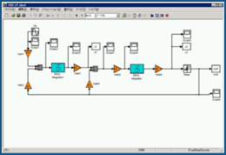
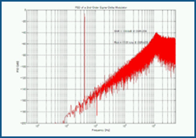
Epson Toyocom Designs and Verifies Mixed- Signal Integrated Circuit in Two Months
Challenge
Develop a mixed-signal integrated circuit with a new 16-bit analog-to-digital converter in two months
Solution
Use MathWorks tools for Model-Based Design to model, simulate, verify, and improve the system-level design
Results
Simulation time reduced from days to minutes
Development time cut by 33%
Millions of dollars saved
Simulink model of the delta-sigma ADC with power spectral density plot.
“Circuit-level simulations took three days. With Verilog-A they took 20 minutes—still too long to enable sufficient exploration of design alternatives. Using MATLAB and Simulink, we reduced simulation time to just one minute.”
- Jun Uehara, Epson Toyocom
Link to user story
Notes:
Primary Industry: Electronics and Semiconductors
Secondary Industries: Communications
Product Capabilities: Algorithm Development, System Design and Simulation, Verification, Validation, and Test
Applications: Digital Signal Processing
Products Used: MATLAB, Simulink
Country: Japan
Epson Toyocom Designs and Verifies Mixed-Signal Integrated Circuit in Two Months
As manufacturers strive to pack more functionality into ever smaller devices, the demand for compact yet highly accurate crystal devices has increased. Crystal devices are essential to many of the advanced features in today’s consumer electronics—for example, they are used to implement clock functions, mobile TV tuners, surface acoustic wave filters, and gyro-sensors used in cell phones, digital cameras, and automobiles.
As components are miniaturized, it becomes much harder to deliver stability and precision at high frequencies using purely analog designs. To solve this problem, engineers are turning to mixed-signal integrated circuits (ICs) that combine analog and digital circuits on a single chip.
Epson Toyocom used MATLAB and Simulink to develop a 16-bit delta-sigma analog-to-digital converter (ADC) for a mixed-signal IC. Modeling and simulation in Simulink enabled Epson Toyocom engineers to make informed design decisions, verify their design early in development, and reduce the number of hardware prototypes, helping the team complete the project within a two-month deadline and saving Epson Toyocom millions of dollars.
The Challenge
When Epson Toyocom engineers began developing the delta-sigma ADC, they had no existing design that could be adapted or reused. Without a reference design, the team would have to evaluate a wide range of parameters, including input capacitance, output voltage, operational amplifier (op-amp) gain, and slew rate. “We needed to run numerous simulations to sufficiently explore all the alternatives,” explains Jun Uehara, QI project, Epson Toyocom.
The team had just two months to design and lay out the ADC, which meant the specification had to be completed in the first two weeks. There was not enough time to use circuit-level or Verilog-A–level simulations to explore design options. Furthermore, to meet the project deadline, the team would need to rapidly simulate and verify any design changes as soon as they received the first IC prototypes.
“Circuit-level simulations took three days. With Verilog-A they took 20 minutes—still too long to enable sufficient exploration of design alternatives. Using MATLAB and Simulink, we reduced simulation time to just one minute.” — Jun Uehara, Epson Toyocom
The Solution
Epson Toyocom used MathWorks tools for Model-Based Design to model, simulate, and verify the 16-bit delta-sigma ADC.
The engineers used Simulink to model the system architecture and the initial system design. The input capacitance, op-amp gain, and other key characteristics were implemented as modifiable design parameters.
After verifying the basic functionality of the Simulink model via simulations, the engineers developed MATLAB scripts that programmatically updated the system parameters in the model. They then performed numerous simulations in which parameter values were systematically varied across their ranges to identify the combination of values that minimized thermal noise and maximized the signal-to-noise ratio.
They used MATLAB to visualize the simulation results, such as power spectral density as a function of frequency. They also evaluated design tradeoffs using MATLAB. For example, the team weighed using a higher input capacitance to improve noise reduction against the additional expense of the high-quality amplifier that would also be needed.
Once they had identified parameter values that fulfilled all the system requirements while minimizing costs, Epson Toyocom produced engineering samples of the design. Lab testing of these IC prototypes revealed a higher level of harmonic distortion than expected, which was reducing the signal-to-noise ratio.
The engineers used Simulink to diagnose the problem, identify its cause, and gain deeper insight into the behavior of their design.
Using MATLAB, they developed a compensation algorithm to address the distortion problem. They incorporated this algorithm as a functional block in the Simulink system model. After running simulations to verify that the distortion had been sufficiently reduced, they updated the IC design with this fix.
The Results
■ Simulation time reduced from days to minutes. “Using our conventional approach, the simulation of a system model took days when performed at the circuit level,” says Uehara. “Simulink enabled us to simulate the entire design at the system level and complete the simulation in one minute.”
■ Development time cut by 33%. Epson Toyocom completed the mixed-signal IC development within the two-month deadline. The engineers estimate that the project would have taken three months using their conventional development approach.
■ Millions of dollars saved. After identifying a problem in the first IC samples, the engineers implemented a fix in Simulink. They verified this fix in minutes. Using the team’s previous simulation methods, it would have taken an entire day. Verification via Model- Based Design enabled Epson Toyocom to reduce the number of IC samples built, saving millions of dollars in mask and prototyping costs.
Learn More About Epson Toyocom: www.epsontoyocom.co.jp/english

Slide 14
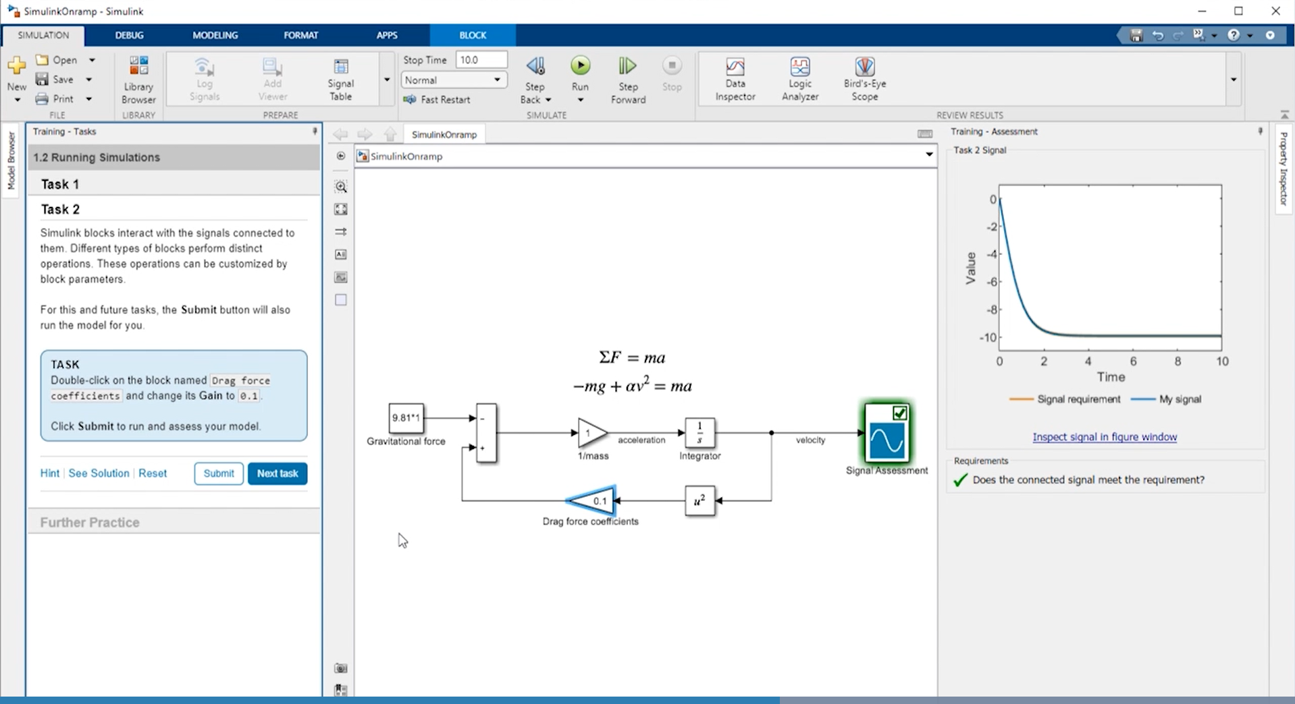
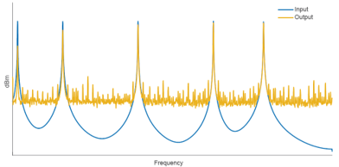
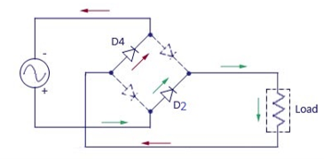

Circuit Simulation Onramp
Free, short course on the basics of simulating electrical circuits in Simscape
Brief videos & hands-on exercises
Automated assessments & immediate feedback
Access online or from Simulink (R2021b or later)
Topics include:
Building circuits such as bridge rectifiers and lowpass filters
Incorporating non-linear components and
op-amps
Measuring and understanding frequency response of filter circuits and using them to remove noise from a signal

Slide 15
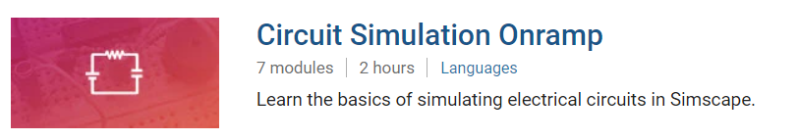
TO DO
Go to https://matlabacademy.mathworks.com/
Log in to your MathWorks account
Launch Circuit Simulation Onramp

Slide 16
Prizes
Complete at least 50% of Circuit Simulation Onramp to be eligible for any prize
Bring your laptop when you come to collect the prize
Follow Us on Facebook!
Find us on Facebook at [Insert Facebook Group Name]

